Slide 1
Teaching practice interview
Name: Nada Khalil Bin Took
Course: EPC3403 Practicum 3a
Instructor: Antoinette Wiseman

Slide 2
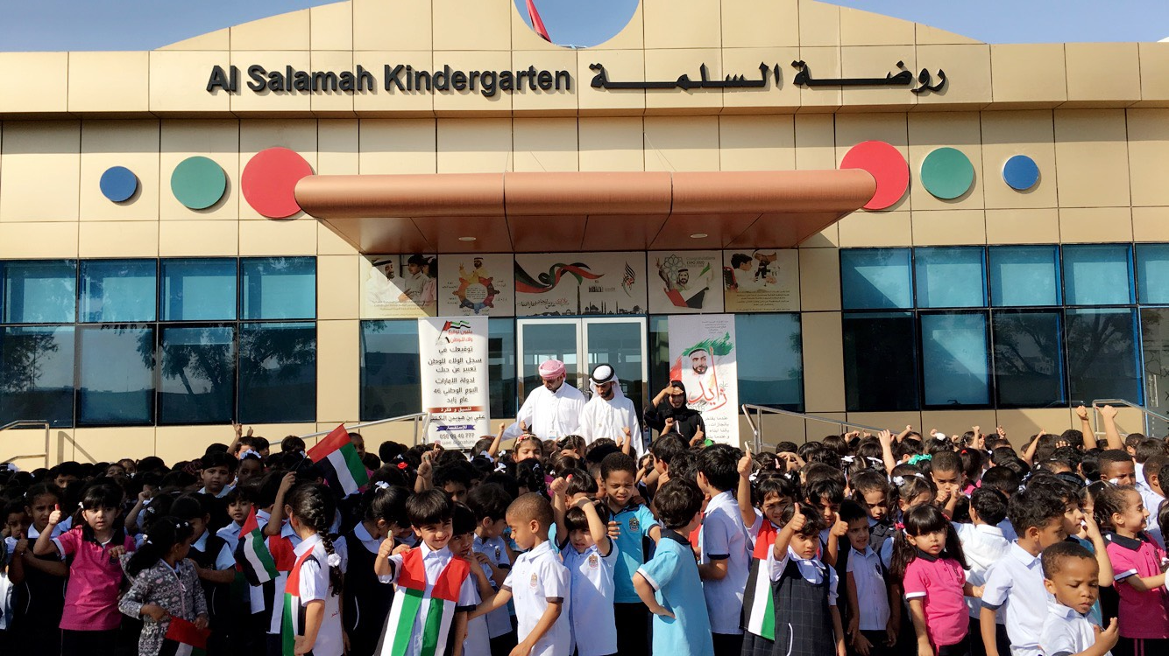
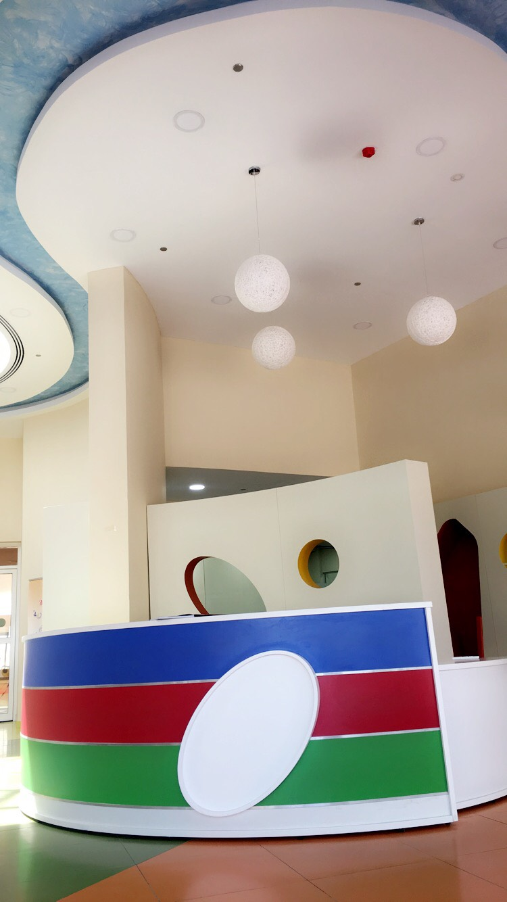
Entrance of the school

Slide 3
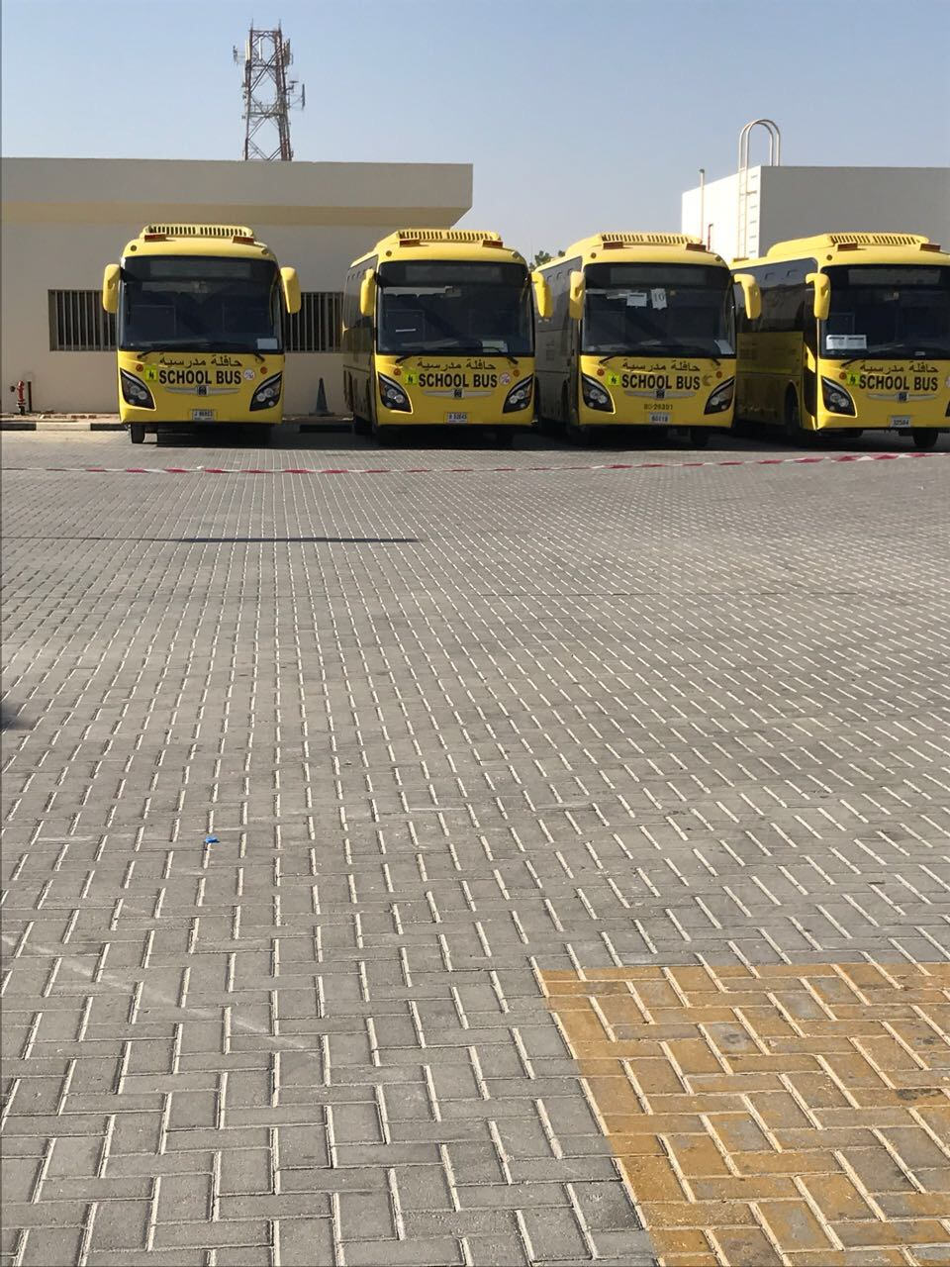
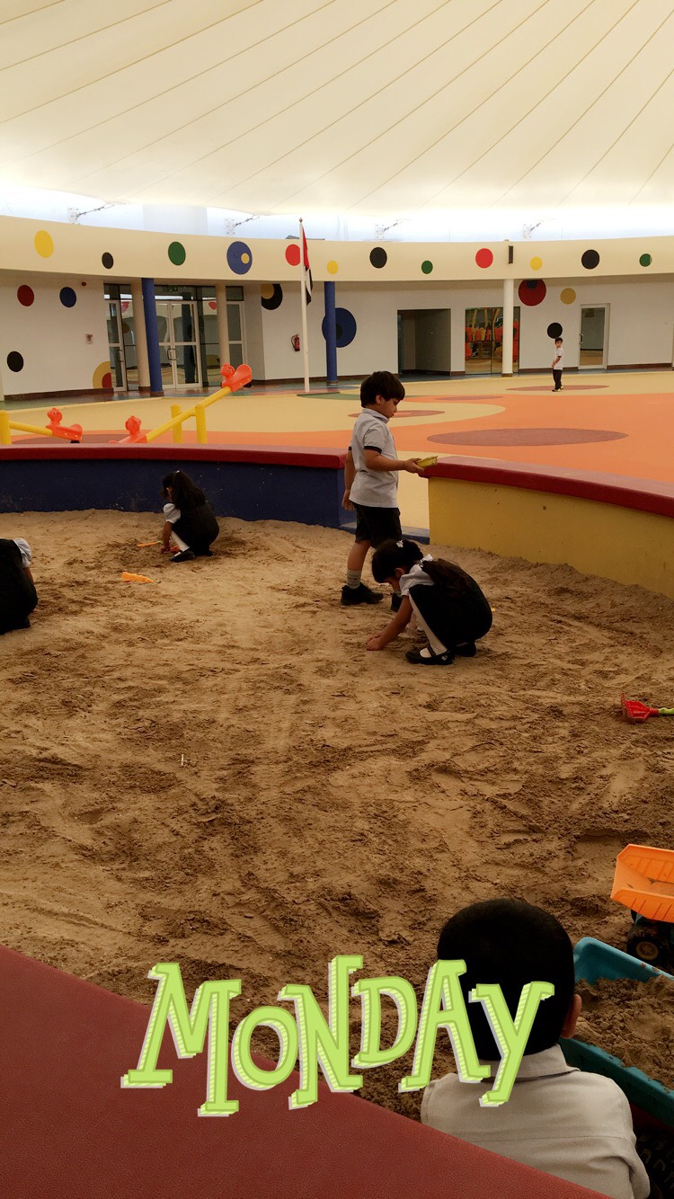
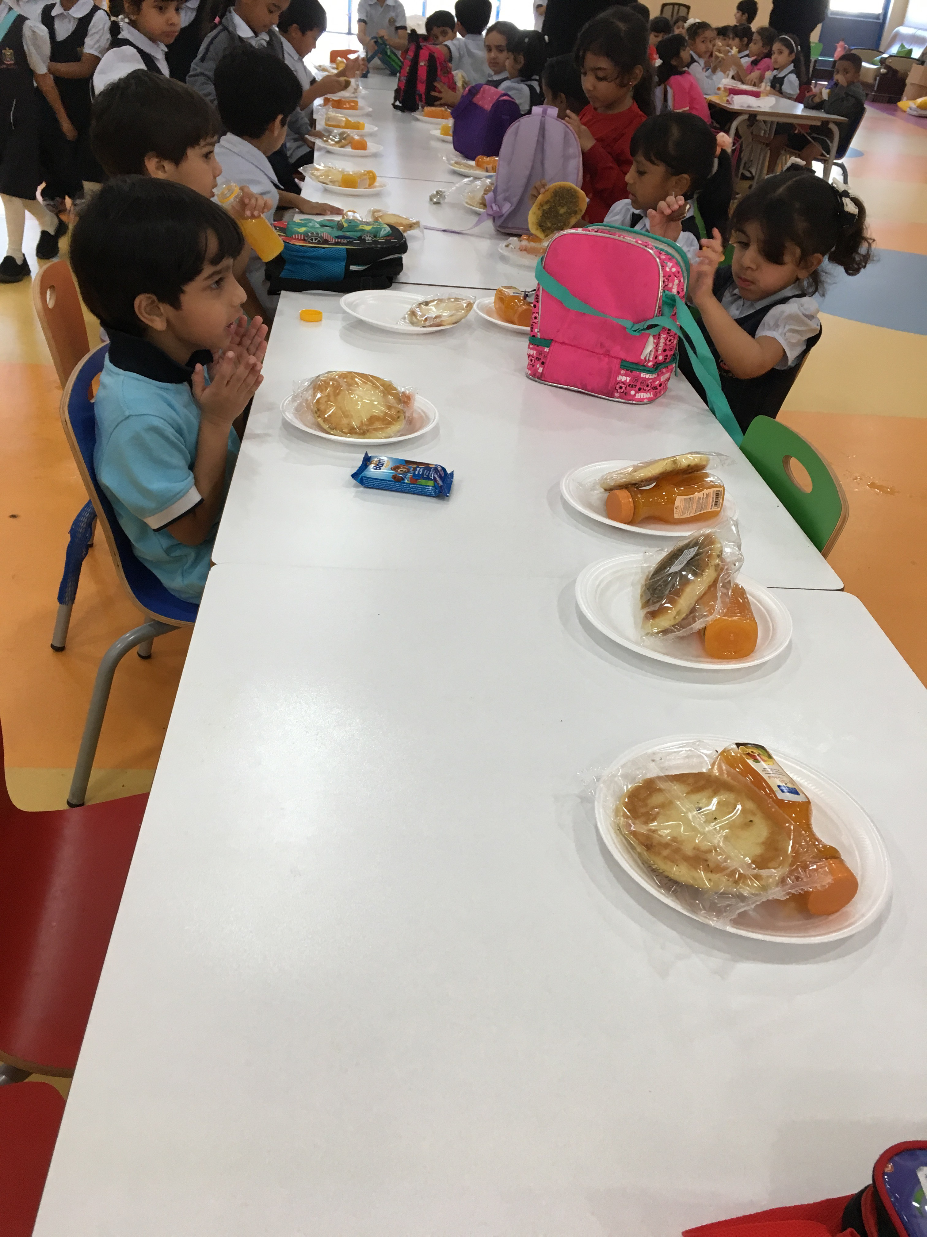
Sections of the school
Bus station | Restaurant | Playground

Slide 4
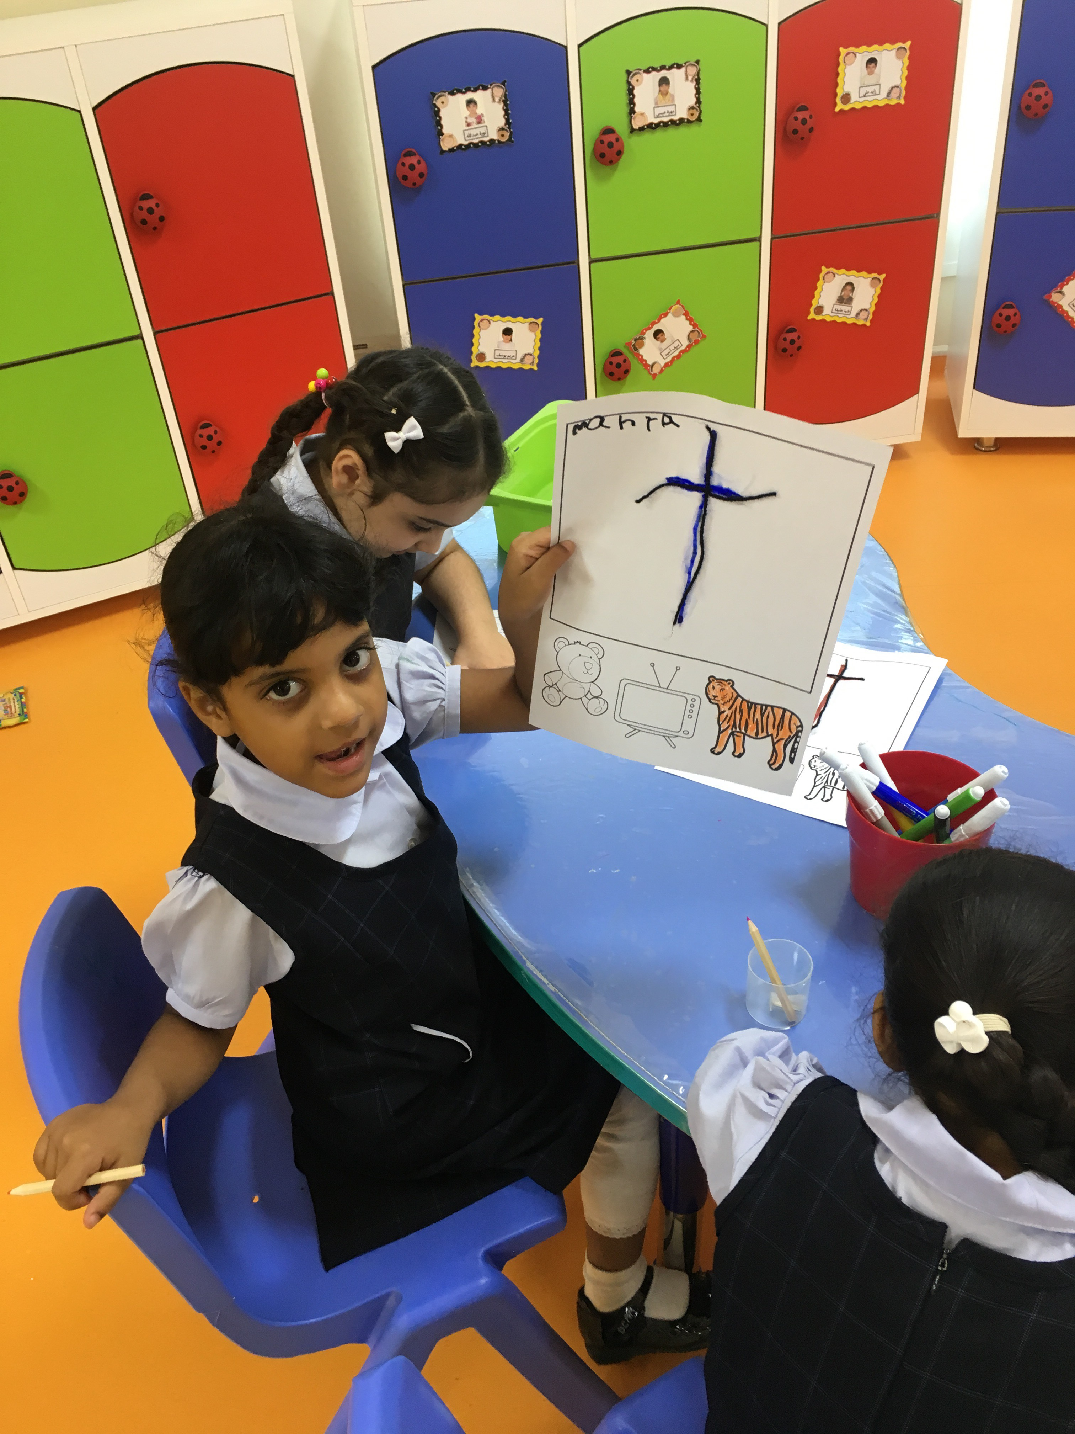
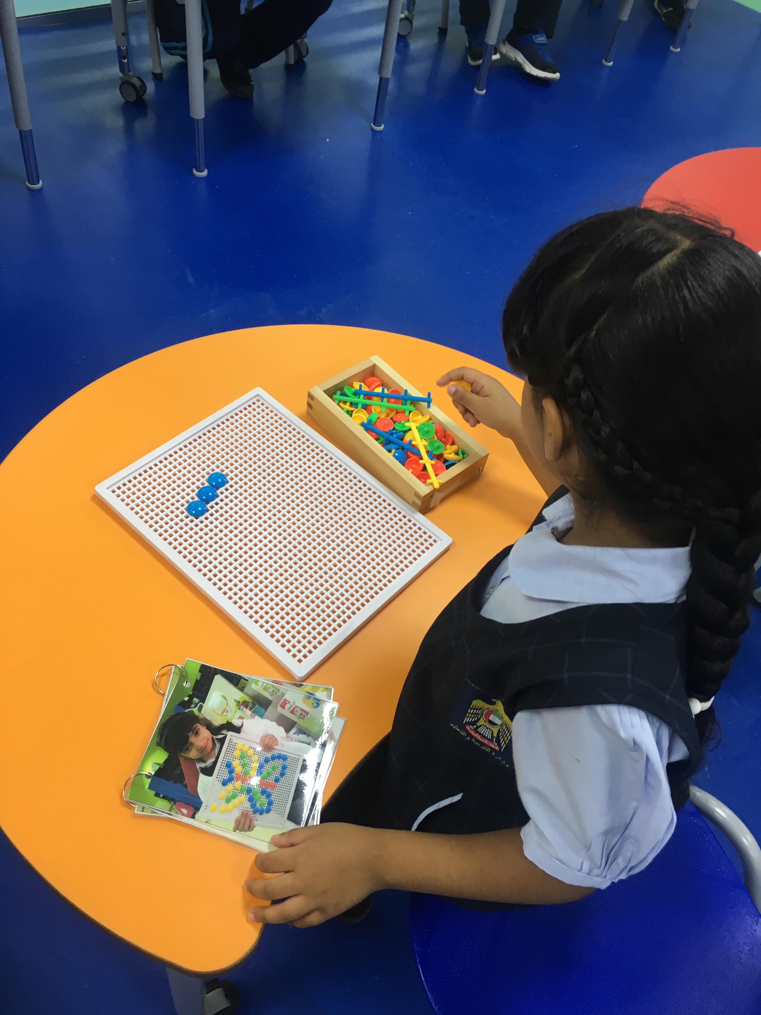
Work activities
Using bottoms to make a butterfly.
Tracing letter n, glue a thread on it and colour the pictures below.

Slide 5
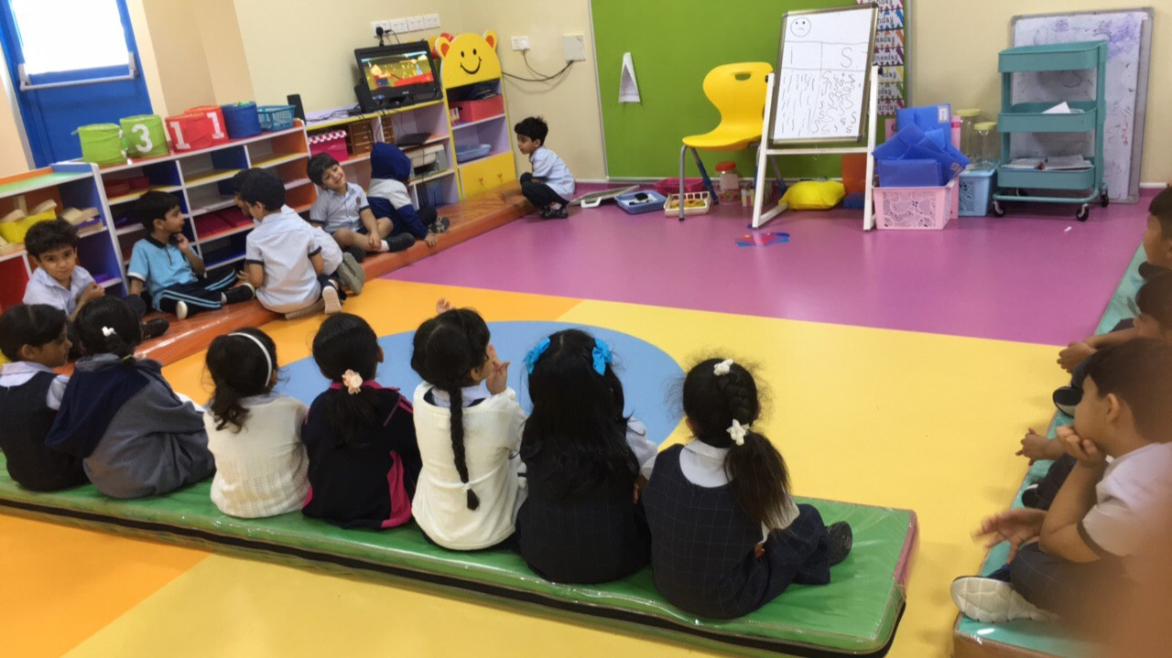
Children interactions

