Slide 1
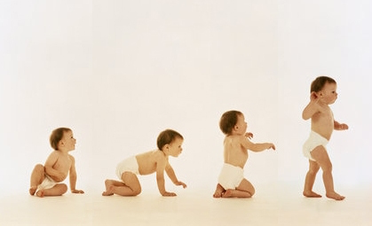
Stages of Development
Amal Yousif
Noura Ibrahim
Nada Khalil

Slide 2
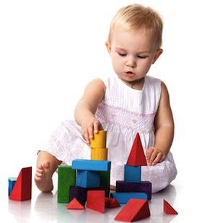
12 MONTHS
What can my baby do this month?
Your baby may soon be
Walking
You may be able to persude him to help tidy up his toys
He will be mors comminicated
You can teach him manners, such as saying please and thank you.

Slide 3
12 MONTHS
What sort of activities will the baby enjoy?
The way your baby plays may be changing as he nears his first year. Now that he has perfected the art of picking up and manipulating small objects with his hands, he may be interested in more energetic play to strengthen his arms and legs. Your baby will still be entertained by quieter activities for a few minutes, but his favourite games may now be noisier than before.
Your baby probably thinks it's fun to push, throw, and knock everything down. He'll give you a toy as well as take one, and he may like games where he can put blocks in containers and dump them out. This also works with pots and pans. He can put little ones inside bigger ones, and get a thrill out of the loud sounds they make when banged together.
You could fill one of your kitchen cupboards with plastic storage containers and lightweight saucepans for your baby to play with. He will love the freedom of opening the cupboard and playing with the contents stored inside.

Slide 4
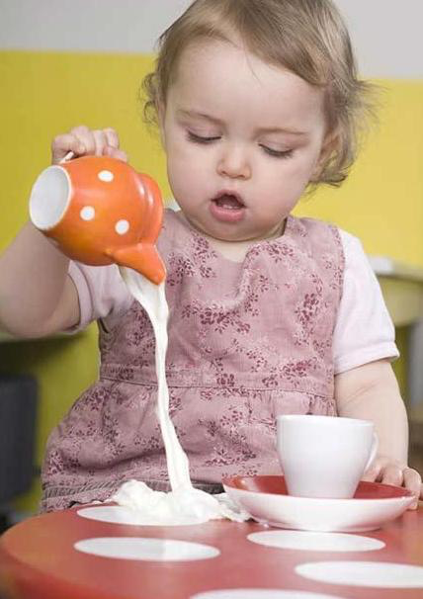
15 MONTHS
By now your toddler may be pretty good at
He may be pretty good at walking
Like to push and pull toys
Confident enough on her feet to stoop to pick up her toys

Slide 5
15 MONTHS
What will my toddler enjoy playing with?
- Your toddler will enjoy small and big toys.
The things you carry in your bag, such as keys, pencils, lipsticks and your phone, will all be fascinating to your toddler

Slide 6
18 MONTHS
What can my toddler do this month?
Your toddler may be walking now but he needs help to climb the stairs.
- He'll love scrambling over the sofa and bouncing around on the cushions.

