Slide 1
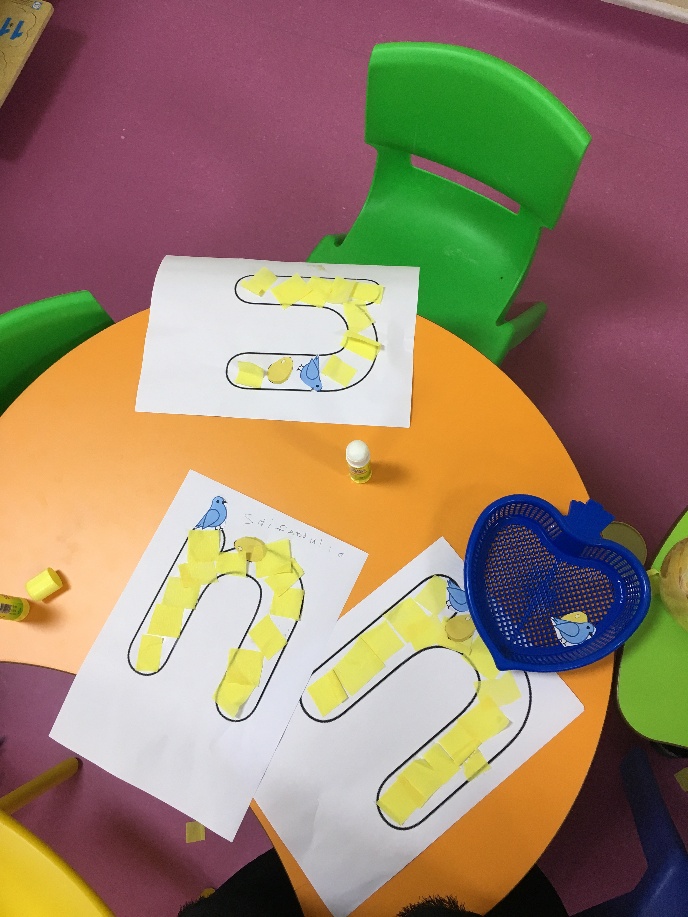
Reflection about certain activity
In this activity children designed letter n using colored yellow papers that represents the nest of the birds. They also glued pictures of egg and bird on it.

Slide 2
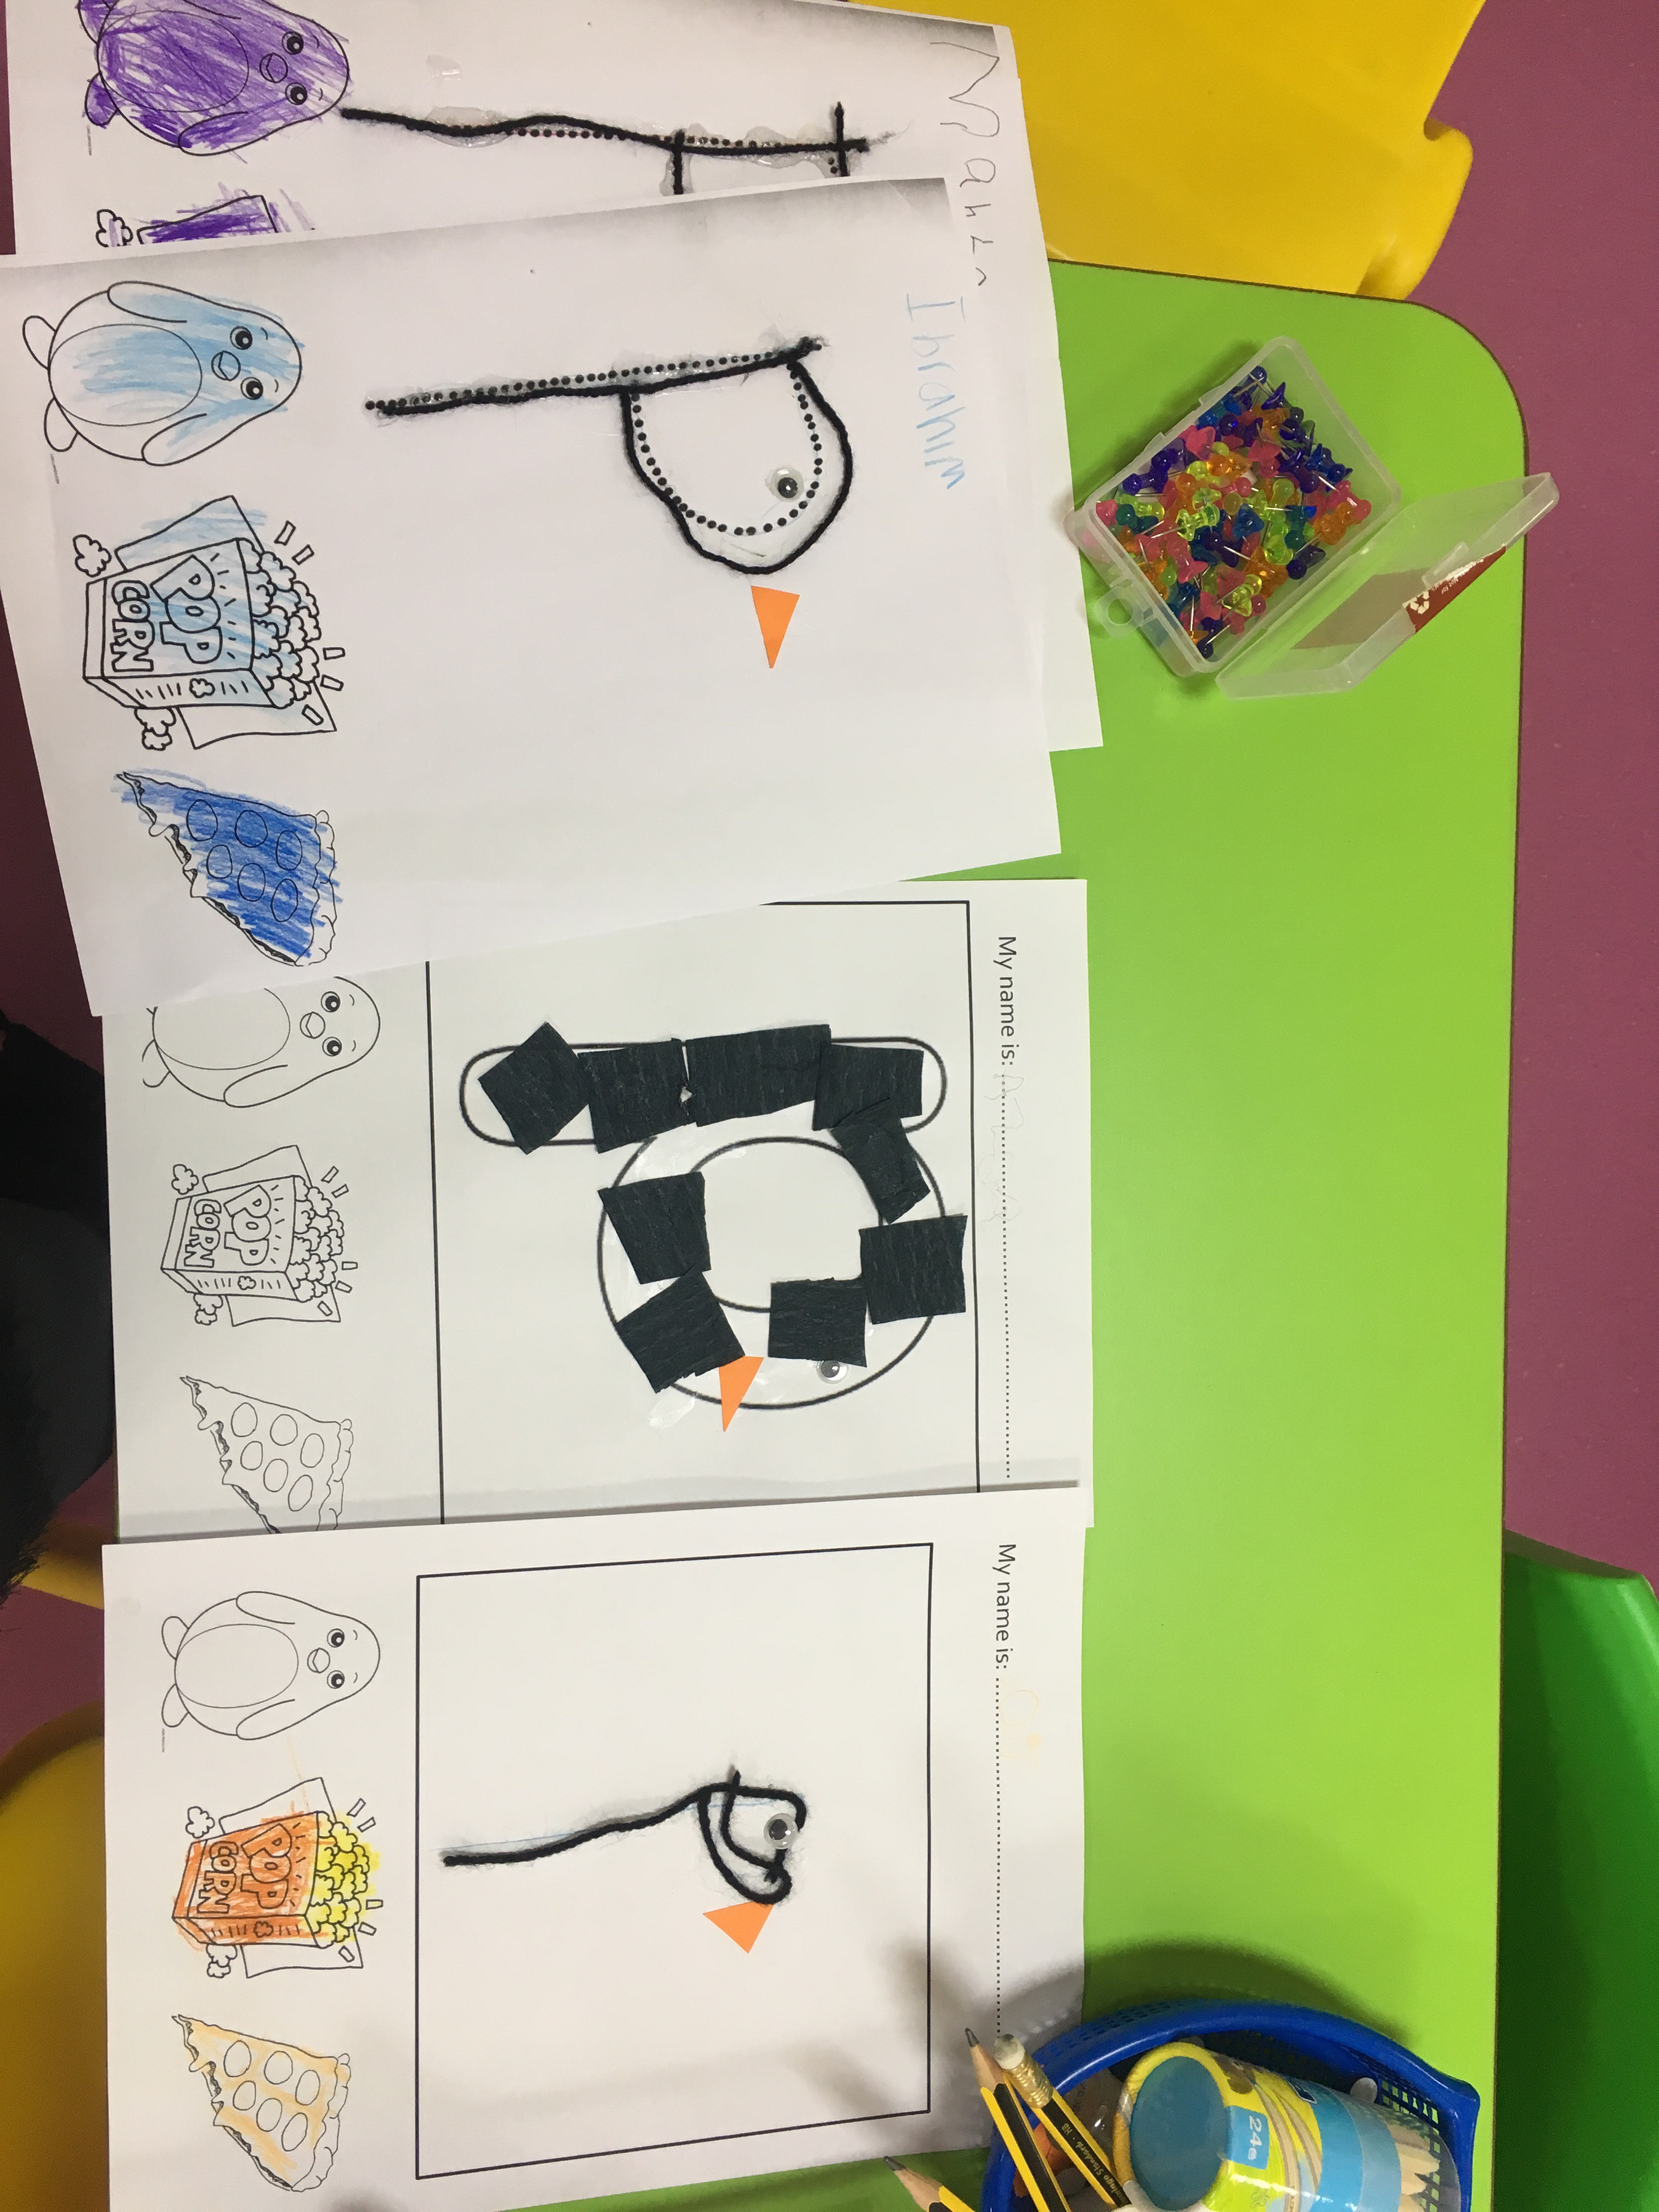
Examples of differentiation
Three differentiated activities for high, middle and low levels. For high level, they wrote letter p, used the thread to glue on it and a mouth and eyes for the penguin, and colored the pictures below.

Slide 3
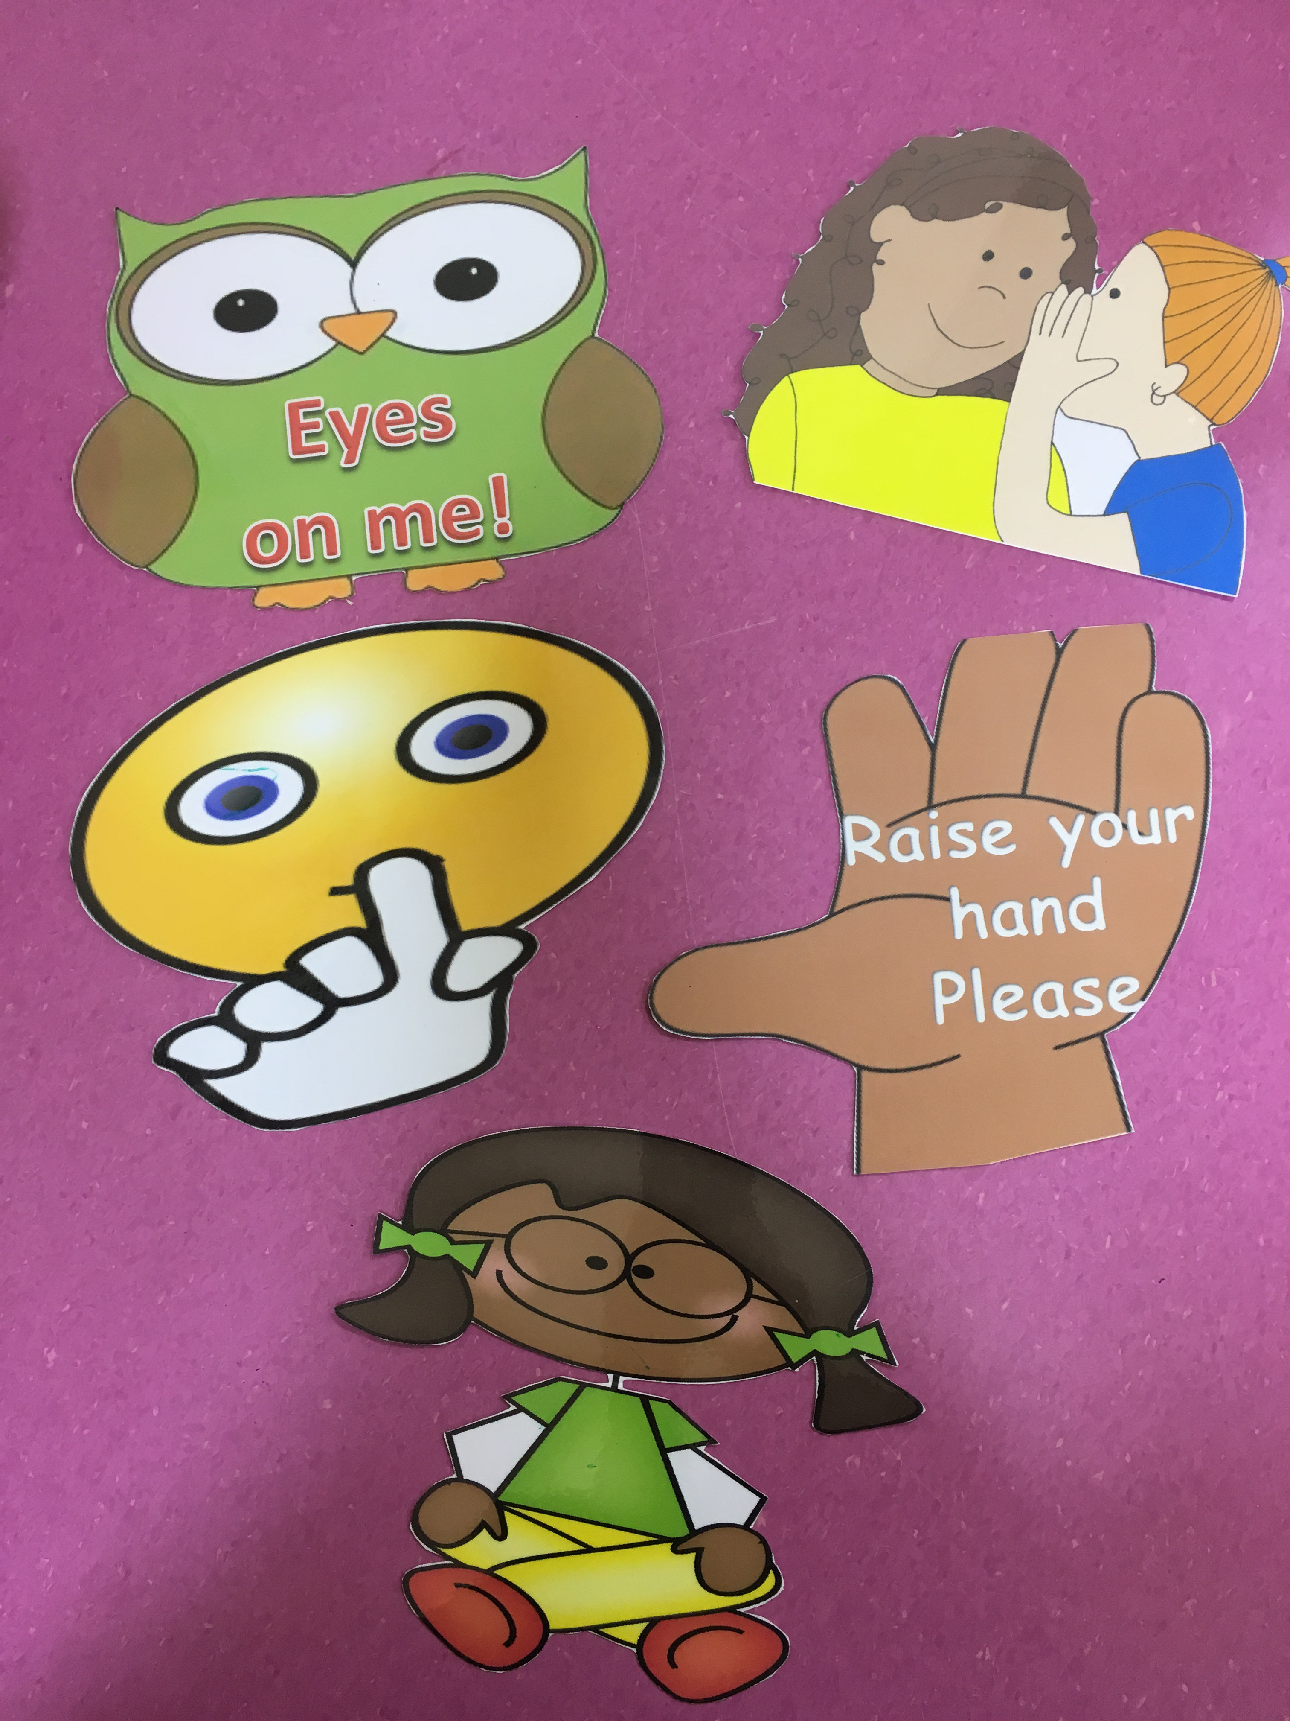
Classroom management
These are the classroom rules flashcards that the teacher and I used. Children know what each flashcard means and when the teacher raises a flashcard they say the rule. This helped a lot to manage children’s behavior and when ever they do something wrong the teacher remind them by the rule.

Slide 4
PDP goal

